Slide 1

Seoul Sustainable Energy Action Plan
One Less Nuclear Power Plant
April 2012.
August 2014.
Phase 1.
Phase 2.
One Less Nuclear Power Plant
Seoul Sustainable Energy Action Plan
In the first half of 2014, 2 million TOE of energy was saved!
26
87
91
83
| Unit : 10,000 TOE |
| Unit : 10,000 TOE |
74
| Unit : 10,000 TOE |
Waste
78
18
Transportation
Renewable generation
Public Sector
- GHG Target
vvManagement System
LED
54
Waste heat recovery
6
BRP
35
Civic Participation
Eco-mileage Program
Limit on cooling
& heating temperatures
Power generation from PV
Hydro fuel cells
Institutional change
- Energy Consumption Quota
Notes:
I am delighted to be given this opportunity to share with you how Seoul is making the city greener.
Seoul’s flagship environmental policy is called One Less Nuclear Power Plant, which was first launched in 2012 and is now in its second phase since 2014.
The policy is about saving energy by the amount equivalent to the output of one nuclear power plant through a wide range of renewable energy generation, energy efficiency improvement and energy conservation efforts.
In the first half of 2014, Seoul achieved the target of saving 2 million TOE of energy.

Slide 2



Phase2.
One Less Nuclear Power Plant
Generation
ㆍ
Efficiency
ㆍ
Saving
Electricity
Self-reliance Rate
20%
GHG Emissions
4m-TOE cut
10m-ton cut
1,000M
By 2020
Transition to ‘Energy Independent City’
Notes:
Seoul is now on its way to reduce two nuclear power plants by 2020.
The other targets of the second phase include increasing electricity independence rate to 20% and cutting carbon emissions by 10 million tons by 2020.
What sets the second phase apart from the first one is its focus on energy welfare.
Let me now share with you some of the details of the policy.

Slide 3
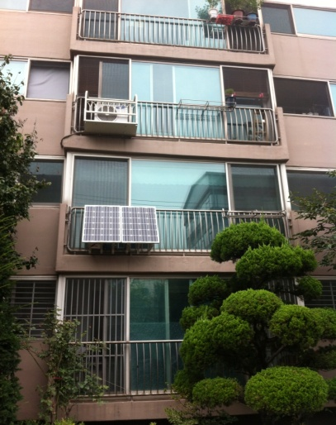




‘Solar City, Seoul’ Project
Expansion of Decentralized/Solar PV Power Generation
Domestic Micro PV Power Panels
- financing 50% of panel installation costs
- total capacity : 8,560kW generated (2015)
Seoul Feed-in-Tariff(FIT)
- supporting small PV power generation
less than 100kW
Solar Power Capacity of 105.01MW (’03.1 ~ ’15.12)
Public
Buildings
Private
Buildings
Schools
Micro PV
43.04
12.49
31.74
17.74
Notes:
Under the One Less Nuclear Power Plant policy, Seoul is promoting decentralized renewable energy generation.
Solar is the best renewable source in Seoul as the city is densely populated with a large number of high-rise buildings.
Seoul has installed solar power systems on rooftops of buildings within the city and achieved solar power capacity of 105.01 MW by the end of 2015, which is enough to power 36,000 households.
As part of the efforts to expand solar power generation, Seoul is running its own FIT program and offering financial subsidies coving 50% of home PV panel installations.

Slide 4


Civic Participation
Eco-Mileage Program
- Incentivizes energy-saving at home, schools and businesses.
- 1.86 million members (2016)
- GHG emissions cut of 1.95 million tons (2009~2015)
Winner of ‘Fostering participation
In public policy’ Category
Energy Independent Villages
- Local communities putting in collective efforts toward an energy independence
- 55 villages (2016)
Green Leaders
Citizens campaign for energy-saving at a community level
17,800 persons (2015)
Notes:
Seoul actively engages citizens in its administration, and it is also the case with its environmental efforts.
There are 55 energy independent villages and 17,800 green leaders in Seoul.
The Eco-Mileage Program is an incentive program for citizens to save energy in their daily lives.
The mileages earned by saving energy can be redeemed to buy green products and charge public transportation card among others.

Slide 5
Inclusive Climate Action
Seoul Energy Welfare Civic Fund
As of September 2016, 602,000 USD was raised by 1,800 citizens.
Fund channeled into energy welfare support for the energy-poor
- Home energy improvements for the low-income families
- Provision of free LED-replacements, inner tents, and clothes to help cut energy costs
Job Creation for Low-Income Families
180 underprivileged jobseekers hired as energy consultants
Roles
- Inspection of energy performance of 1,300 energy-poor households
- Consulting for energy-saving
- Home energy refurbishments
Notes:
Seoul is also committed to easing energy poverty worsen by climate change and reducing climate risks that disproportionately threaten low-income families.
The Seoul Energy Welfare Civic Fund launched in June 2015 has raised 602,000 USD from the public as of September 2016.
In 2015, Seoul financed energy retrofits for 1,295 households and aims to finance a further 1,050 households in 2016.
Seoul installed approximately 1,600 micro- photovoltaic (PV) panels at public apartments and low-income households in underdeveloped communities.
It also provided 20,000 sets of clothing and 200 indoor tents as part of its efforts to reduce climate risks facing the poor.
Seoul has recruited 180 underprivileged job seekers as energy consultants and welfare workers, responsible for conducting assessments of residential environments, energy welfare support and, retrofitting homes for higher energy efficiency.

